Slide 1
United College of Engineering and Research Name : Savinay Tiwari Roll no. : 2000100310030 Branch : Electronics and Communication Engineering

Slide 2


.....Contents…..
01. | About
02. | Our services
03. | Languages used
04. | HTML
05. | CSS
06. | CONCLUSION

Slide 3

INTRODUCTION
01
02
03
.
About
View
To fulfill customer demand by making them satisfied with our service and delicious food.
provide the best customer results possible & deliver the orders in an organized way.
Objective
Delivering healthy food to our customers in an affordable price.

Slide 4
OUR SERVICES
Time management
Quality
After getting the orders we use the technologies like smart phone for tracking the delivery and bike for delivering the food on time.
For a memorable meal the quality of the service is something that guests often remember as much as the food and drink served.

Slide 5
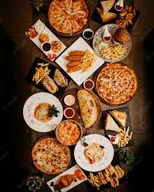
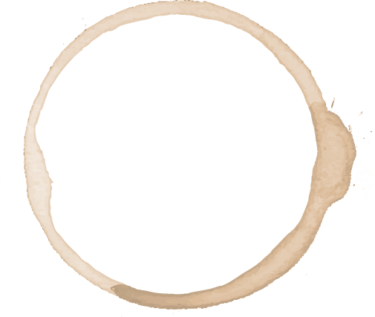
01
About
You can use our website to order delicious food using a simple way.

Slide 6
OMNIPRESENT
uses-
HTML
CSS
JAVASCRIPT
We have used the html elements and tags to create this website.
We have used external css
in our website .
We used javascript to make our web page responsive according to the device.
.HTM
.CSS
.JS

Slide 7

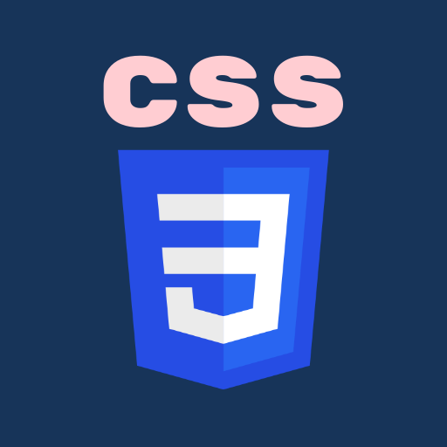
Languages Used……..
HTML
CSS
HTML (Hypertext Markup Language) is the code that is used to structure a web page and its content. For example, content could be structured within a set of paragraphs, a list of bulleted points, or using images and data tables.
CSS (Cascading Style Sheets) is used to style and layout web pages — for example, to alter the font, color, size, and spacing of your content, split it into multiple columns, or add animations and other decorative features.

Slide 8
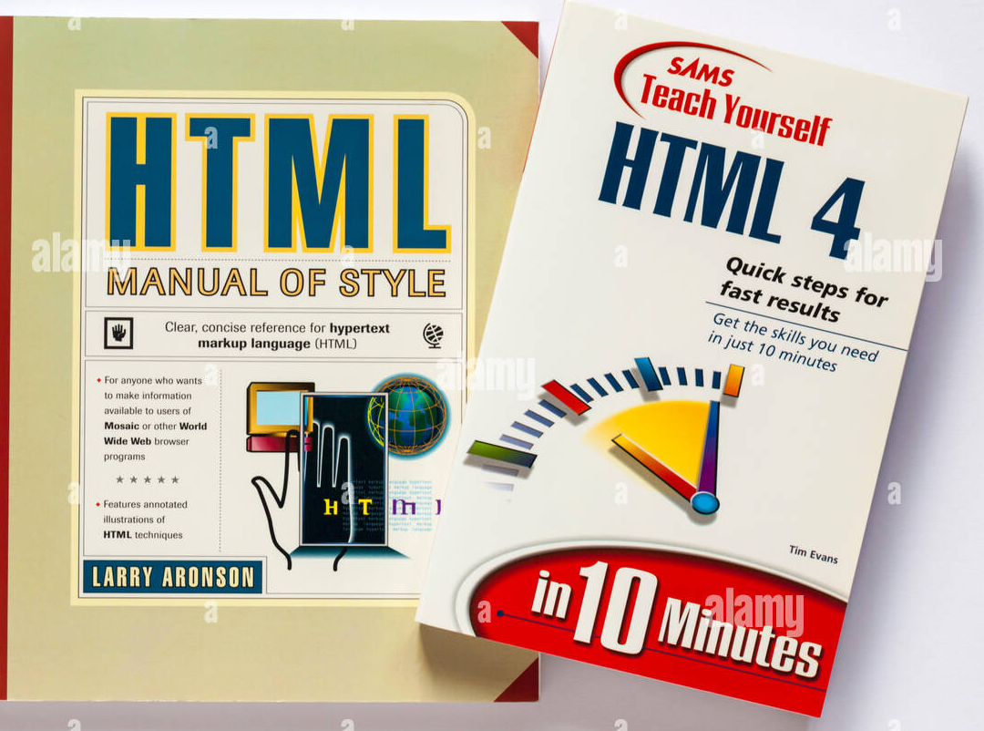
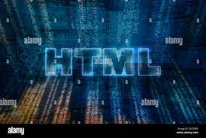

HTML

Slide 9

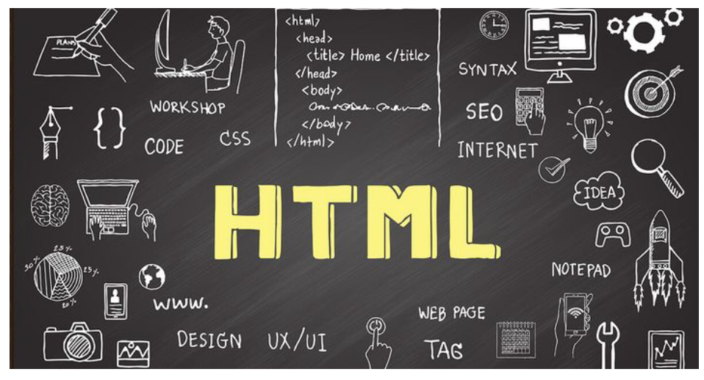
Hyper-text Markup Language

Slide 10

HTML is the standard markup language for documents designed to be displayed in a web browser. It can be assisted by technologies such as Cascading Style Sheets (CSS) and scripting languages such as JavaScript.
Web browsers receive HTML documents from a web server or from local storage and render the documents into multimedia web pages. HTML describes the structure of a web page semantically and originally included cues for the appearance of the document.

Slide 11
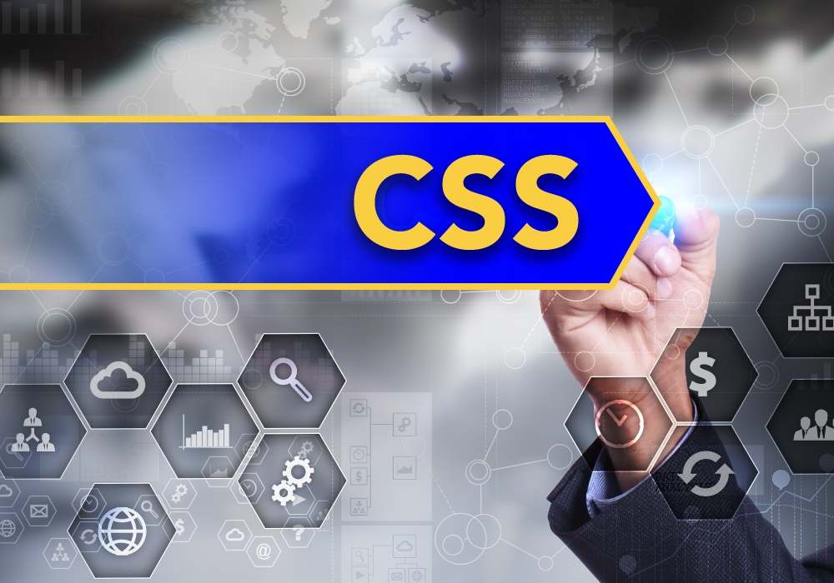
Cascading style-sheet
(CSS) is a style sheet language used for describing the presentation of a document written in a markup language such as HTML or XML (including XML dialects such as SVG, MathML or XHTML). CSS is a cornerstone technology of the World Wide Web, alongside HTML and JavaScript.

Slide 12
So, here is the some screenshots of the webpage.

Slide 13
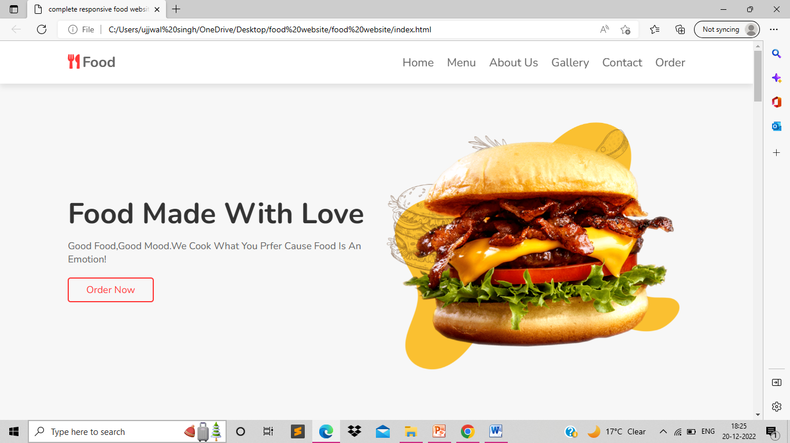

Slide 14
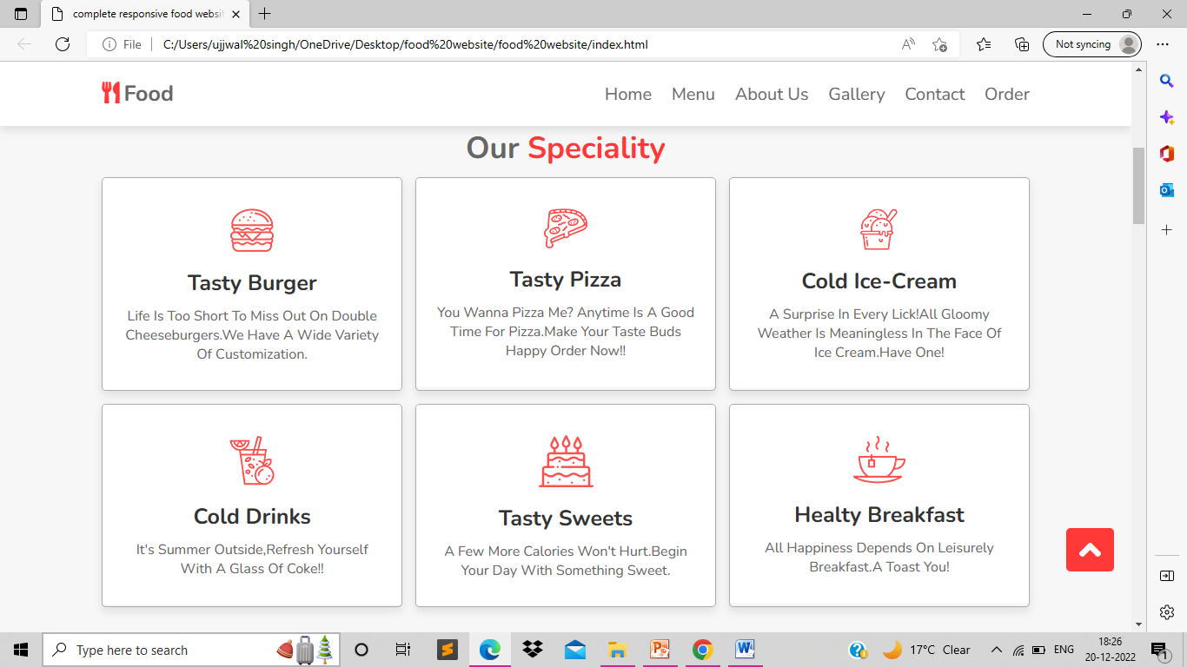
Screenshots
RESPONSIVE VERSION

Slide 15
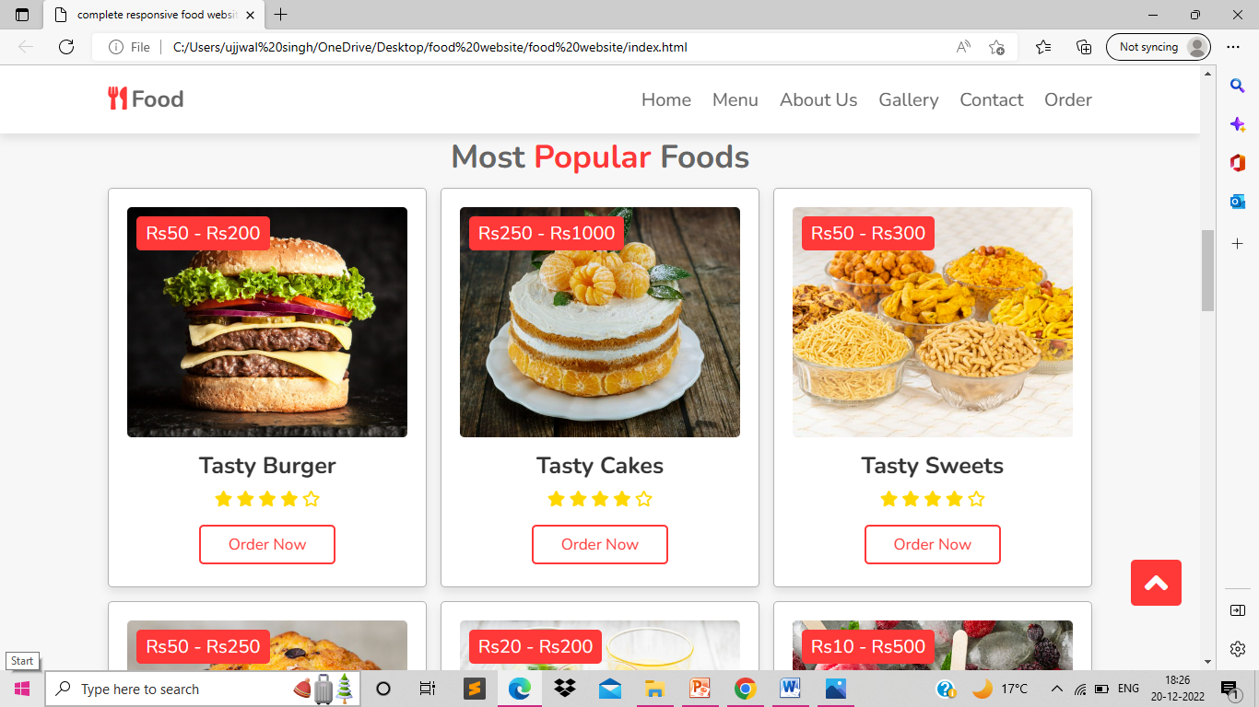
Screenshots

Slide 16
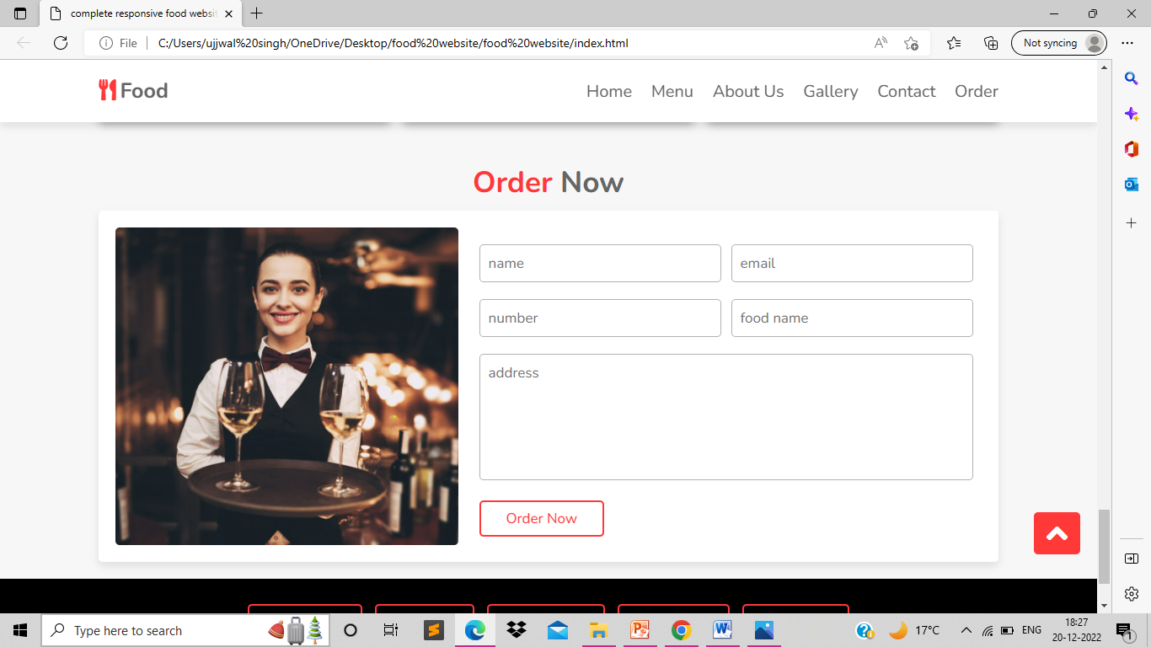

Slide 17
CONCLUSION:-
Our website is made only by using HTML, CSS and JAVASCRIPT.
We only had worked on the frontend of the website . So it is only a static website.
We have started our work on the backend of the website.
We are working on the website . We intend to complete this website
soon.

Slide 18


